Slide 1



Lecture On : Hiring-Mock Interview session
Instructor : Tilak Dadhich

Slide 2
Today’s Agenda
Understanding the skill sets
General interview process
Understanding the perspective of the interviewer
Mock interview
More questions . .
Recommendations

Slide 3
Mapping the skills
Algorithms & Math
Product Companies
Consulting Firms
Engg. & Technology
Business Knowledge
IT Companies

Slide 4



The important skillsets desired in an analyst
Structured Thinking
Problem Solving Techniques
Mindset of the candidate
Structured Thinking
Statistics
Data Analytics
Data Science & ML
Analytics / Algorithms
Business Knowledge
Business Understanding
Customer Lifecycle

Slide 5
The generic hiring process
Aptitude, Quantitative Reasoning
Pseudo codes, Logic Reasoning
Generic round – Resume/ Experience
Technical Round – SQL, R/Python, Data Science
Business Case study
Managerial round
Culture mix - HR
Focus on general quantitative aptitude
Percentages, ratios, probability, Geometry
Coding problems – Pseudo logic for codes
LR / DI questions
Guestimates
Projects in your resume
Reasoning for each event/decision
Create your own story flow
R/Python & data science – trust yourself
ML/Data science related questions
Problem definition
Problem solving
Mindset of the candidate - Learning
Curiosity/ Ability to understand business scenarios – put on different thinking hats
Culture mix – Ethical dilemmas
The Famous Whys

Slide 6

Understanding the perspective of the interviewer ?
ML process
Model architecture design
Thorough understanding of ML
Limitation of ML
Perspective- Model Iterations
Evaluation of the model
Model evaluation statistics
Overfitting, Bias vs variance
Feature Selection
Concepts
& Perspective
Data Exploration & Manipulation
EDA
Data treatments
Outlier definitions
Feature engineering
Dummy variables
Generating inference from the model – consumption
Infer from modelling exercise
Findings and Insights
Hypothesis testing
Implementation Strategy
Notes:
Business math and technology
Solve some more case studies, example which is given is very good , industry reference

Slide 7
Understanding the perspective of the interviewer ?
Data interpretations
Different types of graph based questions, like bar graph, stacked charts, area chart, pie charts etc.
Logical reasoning
LR sets
Concepts
& Perspective
Quantitative ability
Maths
Logical concepts with Maths
Very similar to what you studied at the time of first placements
Till class 12th maths nothing more
Communication skills, verbal ability
Analytical passage
Case studies
Research papers
Usually not a separate paper
Notes:
Business math and technology
Solve some more case studies, example which is given is very good , industry reference

Slide 8




Poll Question
If we divide the data into a 80 – 20 Random split for Train and Test and create the model on Train, does it ensure that our model and underlying strategy will work in the future:
Yes
No
Practice in teams of 4 students
Industry expert mentoring to learn better
Get personalised feedback for improvements
11

Slide 9
Poll Question
What is IQR and how is it used in identifying outliers, What is outlier in the below?
50th percentile + 1.5 IQR
75th percentile + 1.5 IQR
90th percentile + 1.5 IQR
Practice in teams of 4 students
Industry expert mentoring to learn better
Get personalised feedback for improvements
11

Slide 10
Poll Question
Does a gradient descent always give you the best solution in Linear regression:
Yes
No
What type of gradient descent ?
Practice in teams of 4 students
Industry expert mentoring to learn better
Get personalised feedback for improvements
11

Slide 11
Poll Question
I want to run a linear regression on 2000 data points with 4000 variables, will my regression be significant:
Yes
No
Practice in teams of 4 students
Industry expert mentoring to learn better
Get personalised feedback for improvements
11

Slide 12
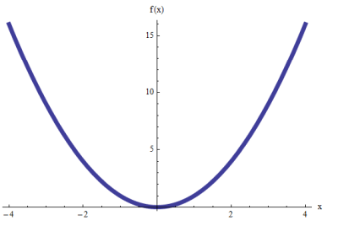
Poll Question
What is going to be the Pearson Correlation Coefficient for the Curve y = x^2:
~1 easily explainable
~0
> 0
<0
Practice in teams of 4 students
Industry expert mentoring to learn better
Get personalised feedback for improvements
11

Slide 13
Poll Question
Can we incorporate a variable which has a non-linear relationship with Y in linear regression somehow:
Yes
No
Practice in teams of 4 students
Industry expert mentoring to learn better
Get personalised feedback for improvements
11

Slide 14
Poll Question
Can we do a linear regression with a different null Hypothesis ( or can regression be used to see if Beta <> 1):
Yes
No
Practice in teams of 4 students
Industry expert mentoring to learn better
Get personalised feedback for improvements
11

Slide 15
Poll Question
If all my variables are insignificant except one variable, the F statistic of the model might be okay:
Yes
No
Practice in teams of 4 students
Industry expert mentoring to learn better
Get personalised feedback for improvements
11

Slide 16
Basic steps in a complete Data Science Project
Defining business objective
Sampling strategies
Exclusions
Defining Dependent variable
Test-Train (80-20) vs Cross validation vs Test-Train-OOT (70 – 15 - 15)
Design of modelling experiment
Observation point
Cool-off period
Performance window
Data EDA – Bivariate and Univariate
Feature Engg.
Outlier, missing value treatments etc.
Segmentation to divide very different populations
Model Building
Model iterations
Feature selection/elimination
Final model selection – performance on Test
Out of Time model validation (OOT performance)
Strategy using the model and some other parameters – discussion with Business
Review of Strategy and Execution plan – Business sign-off

Slide 17
Types of case studies
Problems
Decisions
Evaluations
Rules
Purely Analtyics Case study
Guestimates

Slide 18
Managerial rounds – Resume/ Experience based questions

Slide 19
Resume based questions
Have a story for yourself
Aspiration should be clear / Career Objective needs to be strong
Career decisions should be well thought through, thing should add up
You govern what questions you will be asked – the risk of showcasing things you don’t know
Experience based questions
One project – end to end – detailed discussion
DON’T LIE !

Slide 20
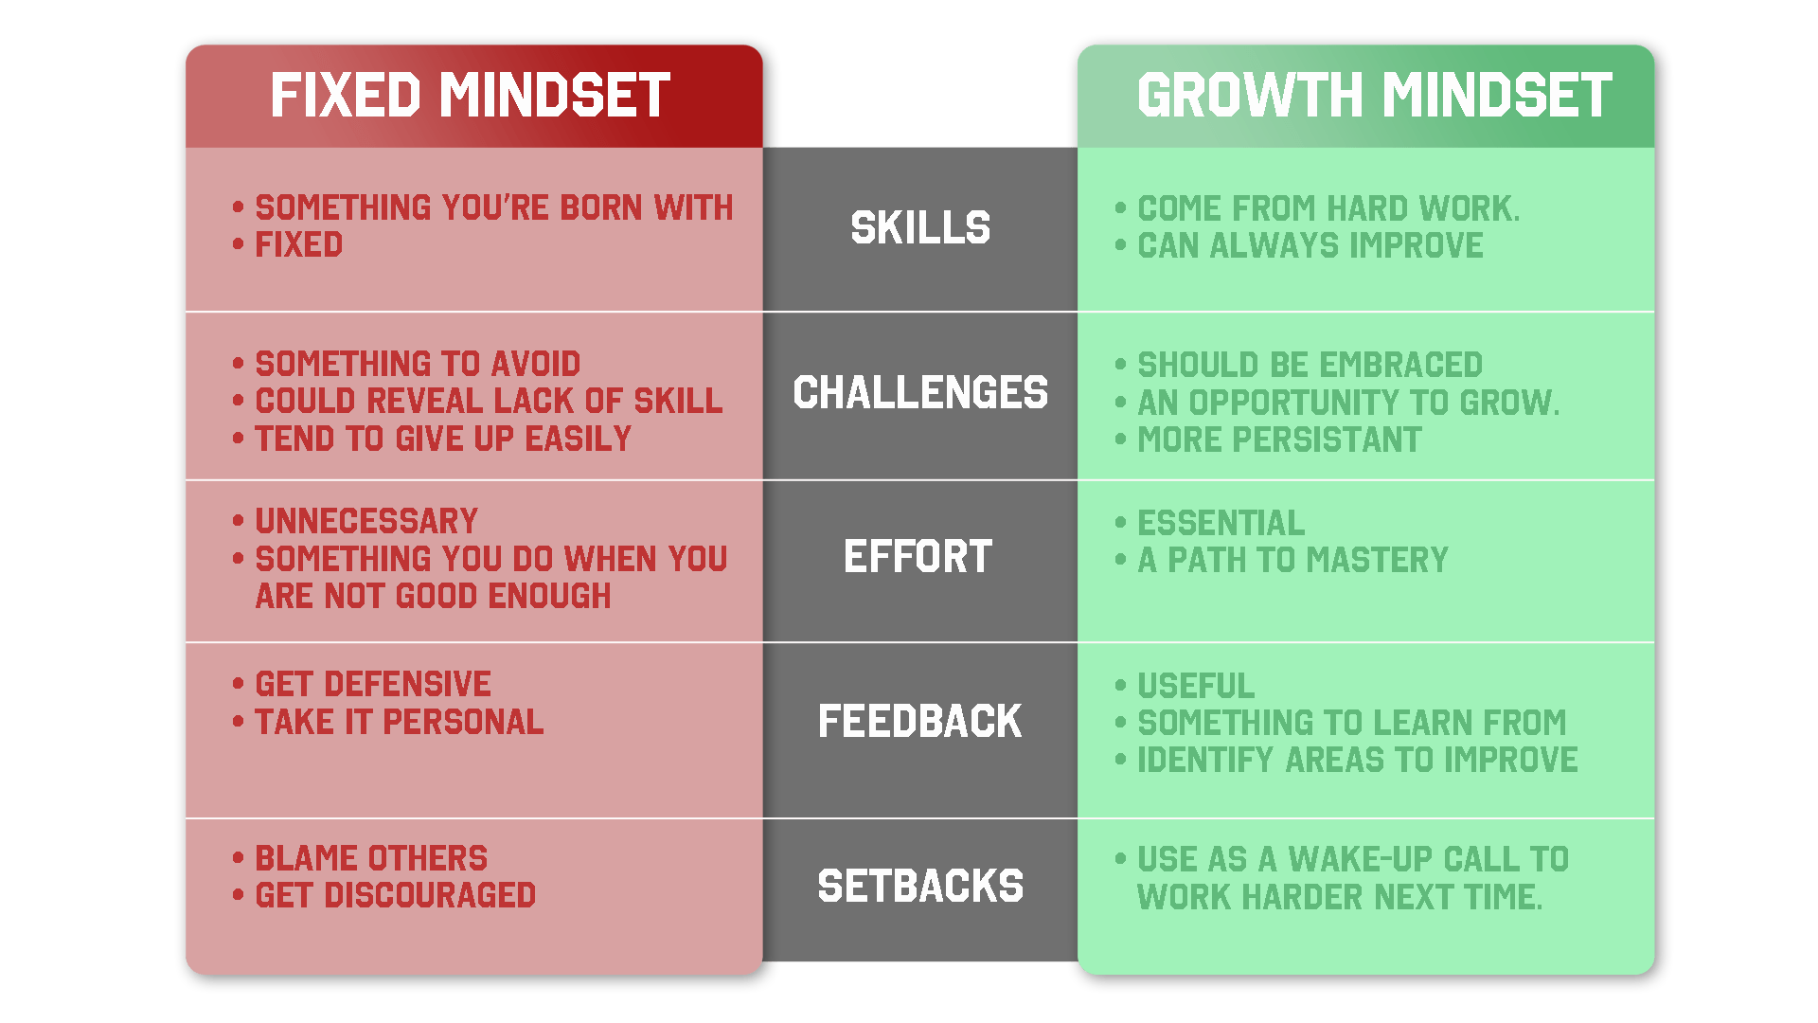


HR rounds
If you have reached till here, you are almost through
Listening skills – Body language
Acceptance – Patience and perseverance
Don’t be an outlier
How do you deal with a failure
Ethical dilemmas
Mindset – philosophy for growth
SMILE ! – HAPPY people are let through . . . .

